Slide 1
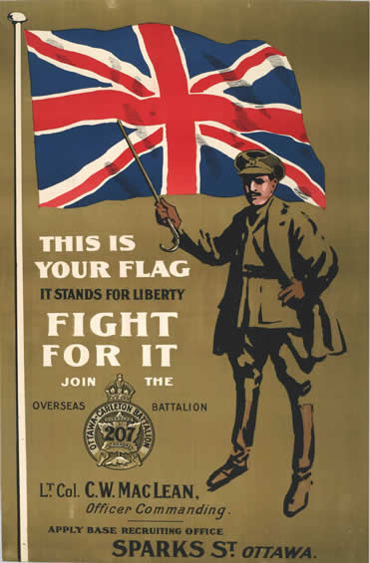
WW1 Propaganda Posters

Slide 2
Propaganda for patriotism and nationalism
The First World War was the first war in which the mass media played a significant part in disseminating news from the Fighting Front to the Home Front.
It was also the first war to target systematically produced government propaganda at the general public.
All the belligerents were therefore compelled to recognise that they had to justify the righteousness of the war and, to this end, themes such as patriotism and nationalism played an important role.

Slide 3
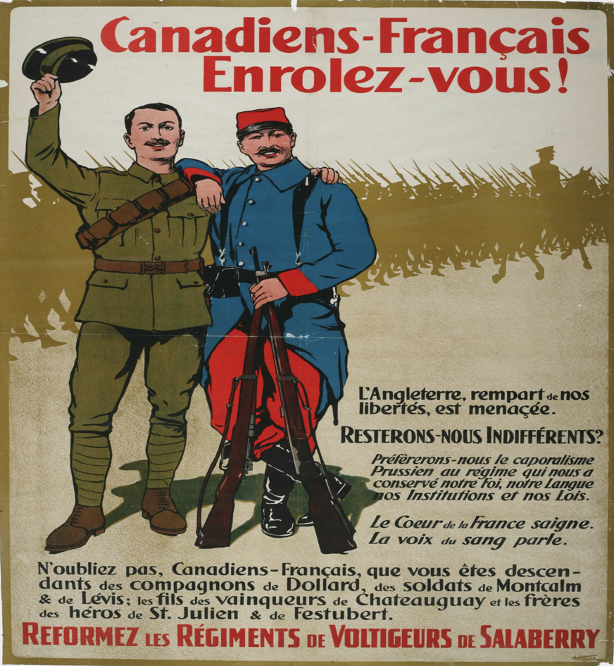
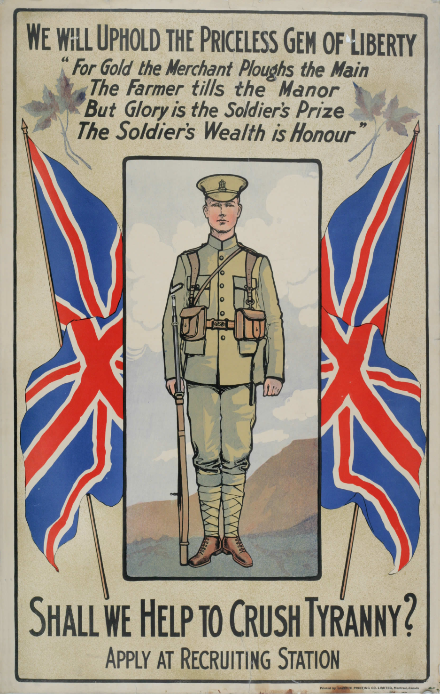

Slide 4
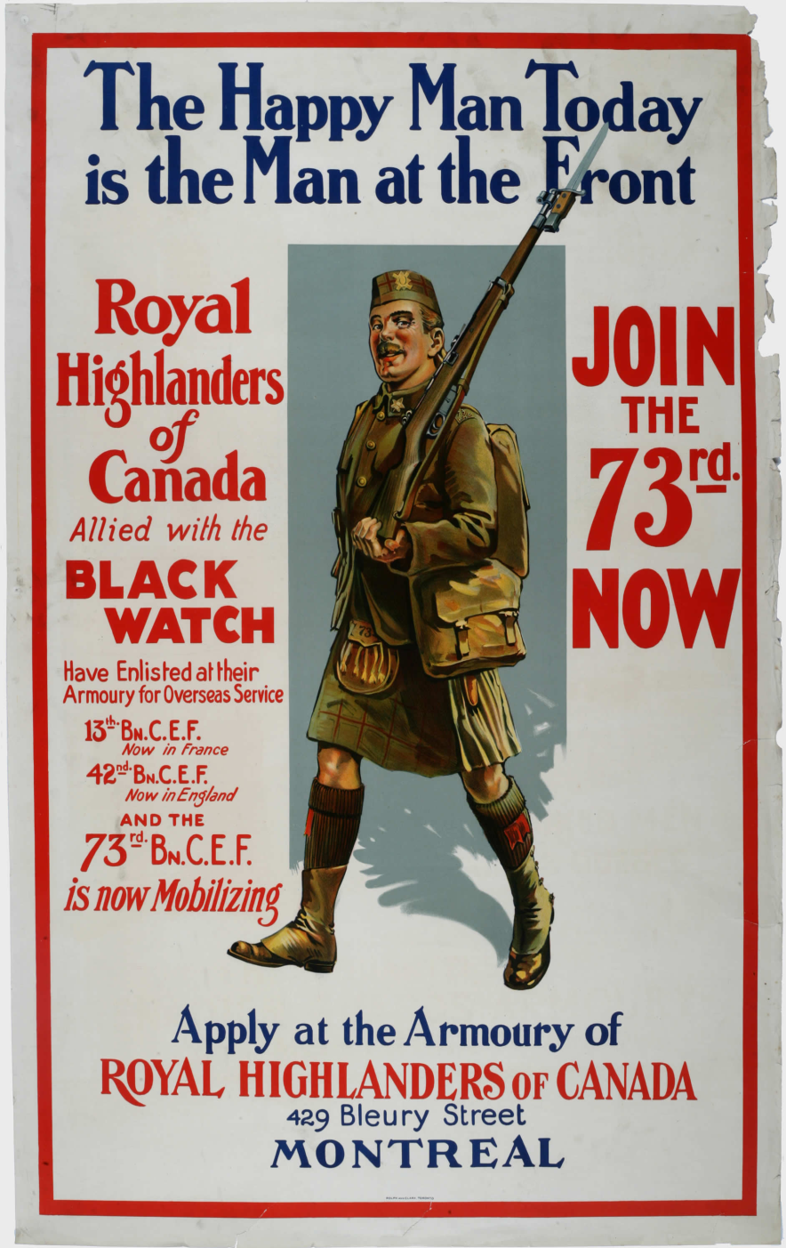
When Canada entered WW1 in 1914, the country went mad and men of all ages enlisted by the thousands.
However, this zeal waned as reports of casualty rates arrived home.
Recruitment posters were an integral part of encouraging men to enlist at all points between 1914 and 1918.
They appealed to the many reasons for enlistment and used various propaganda techniques to achieve their goal.

Slide 5
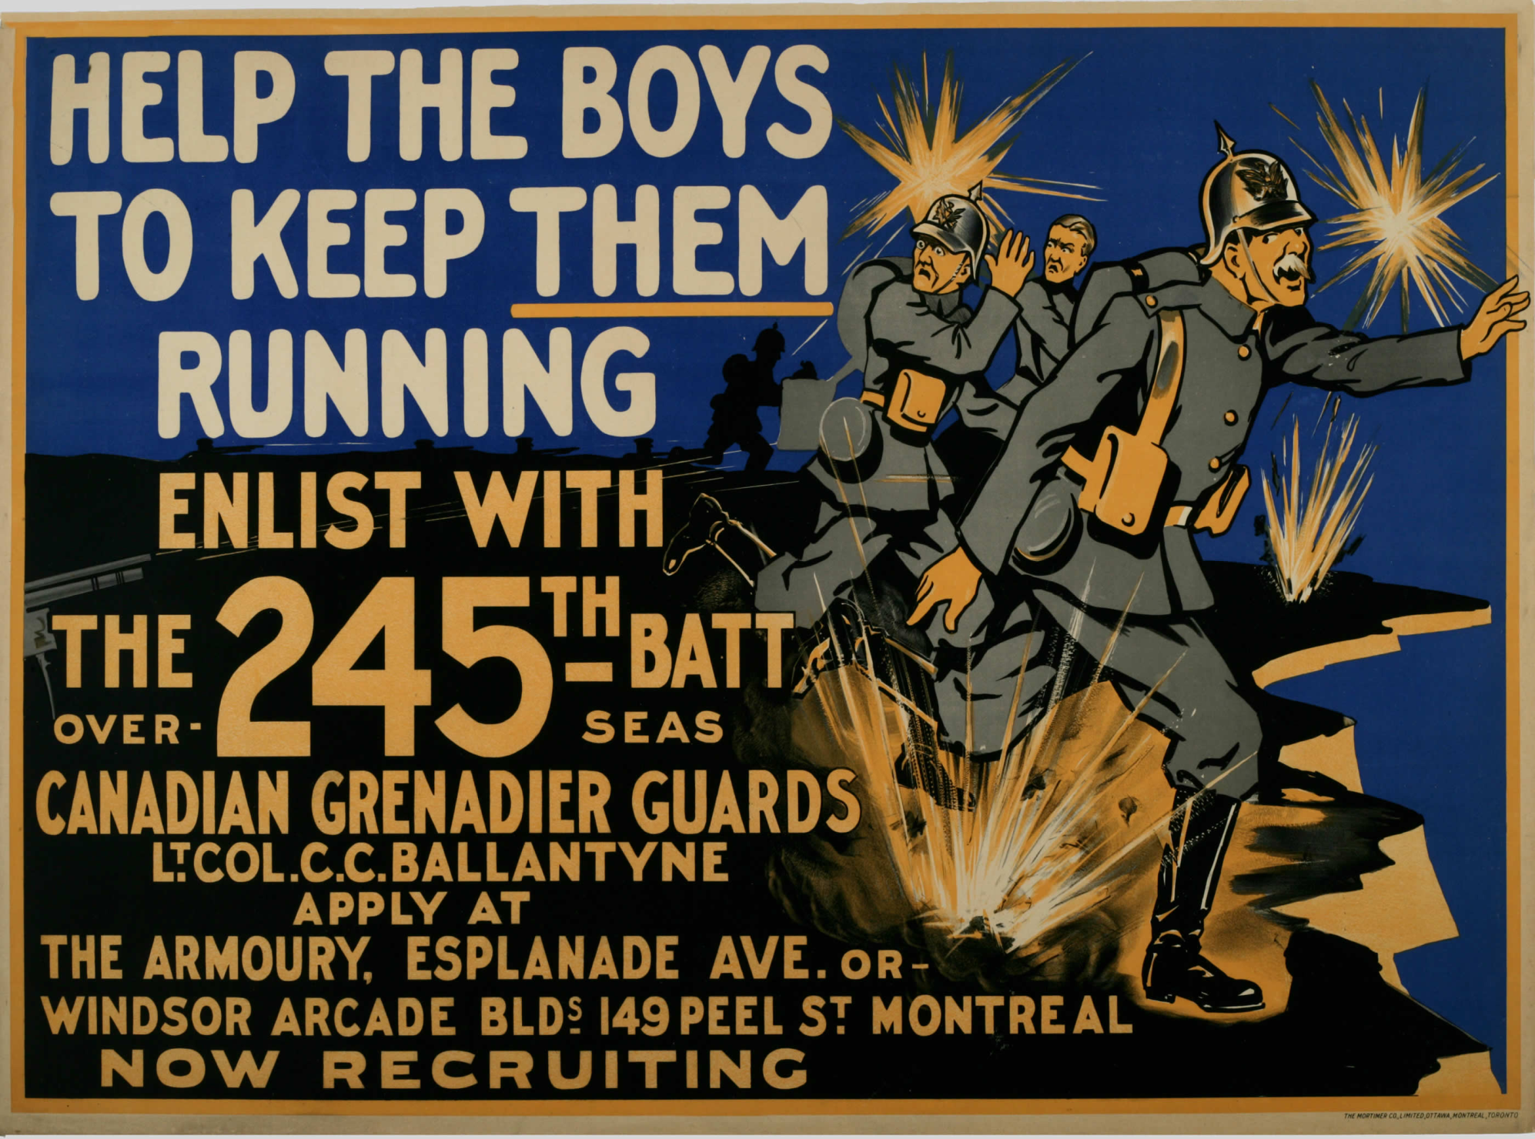

Slide 6
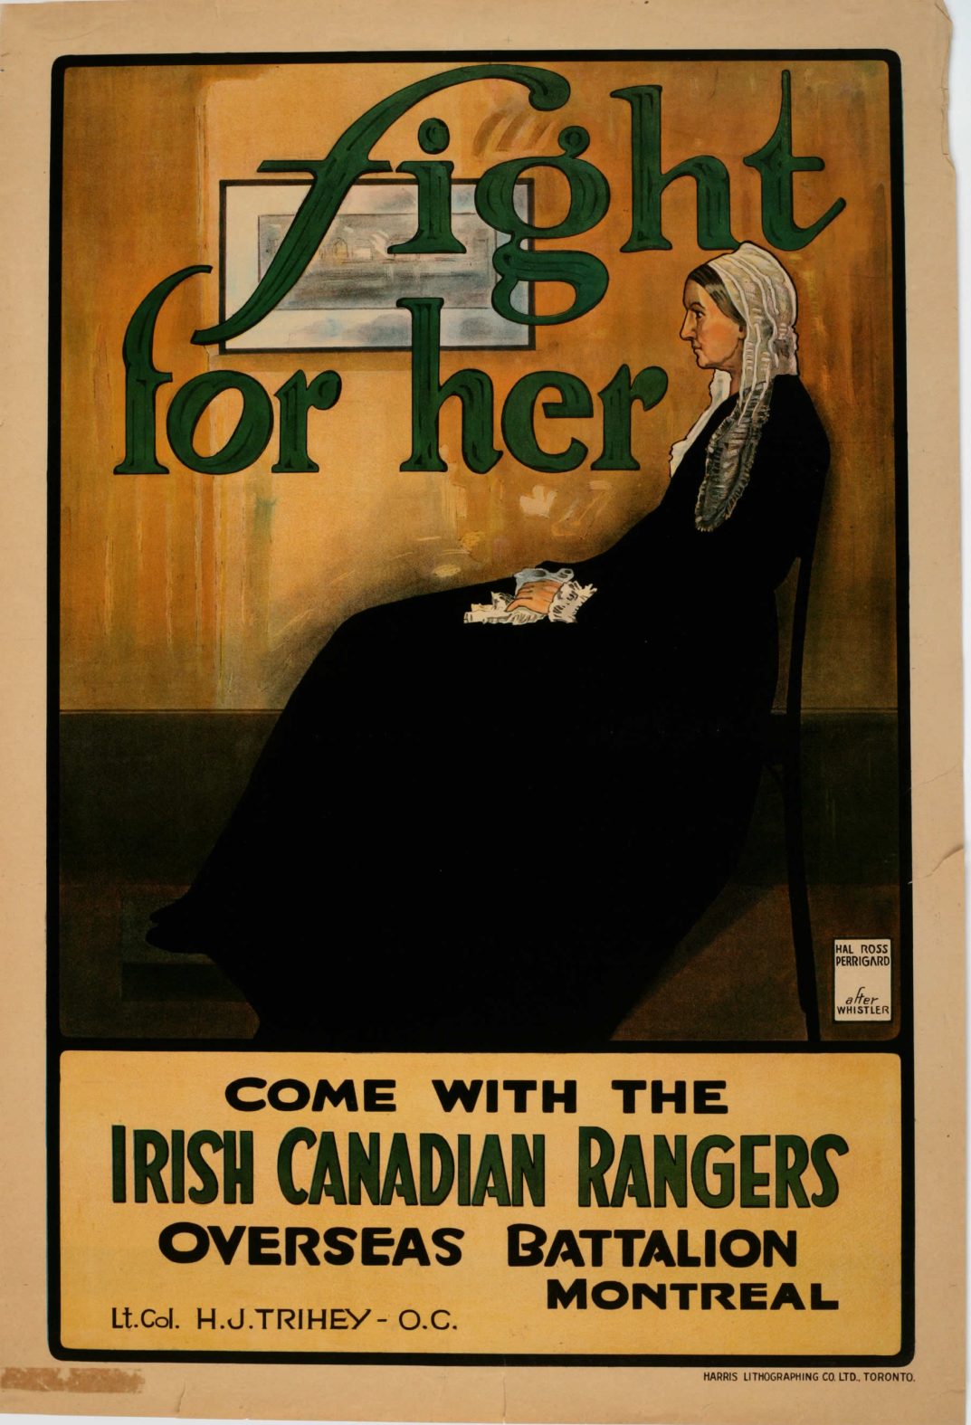
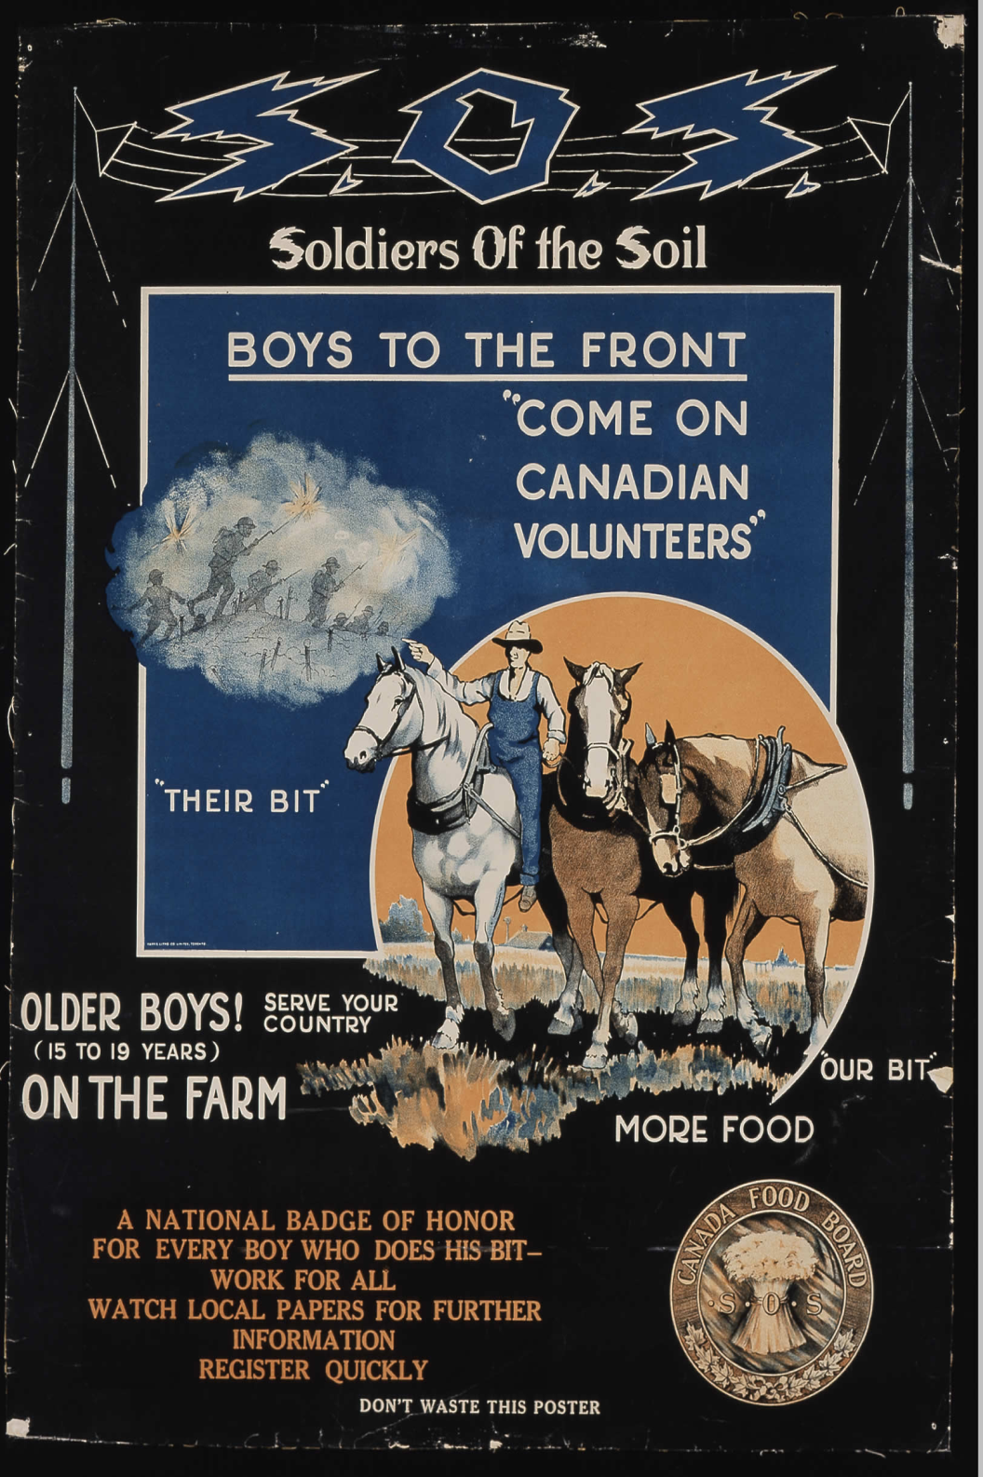

Slide 7
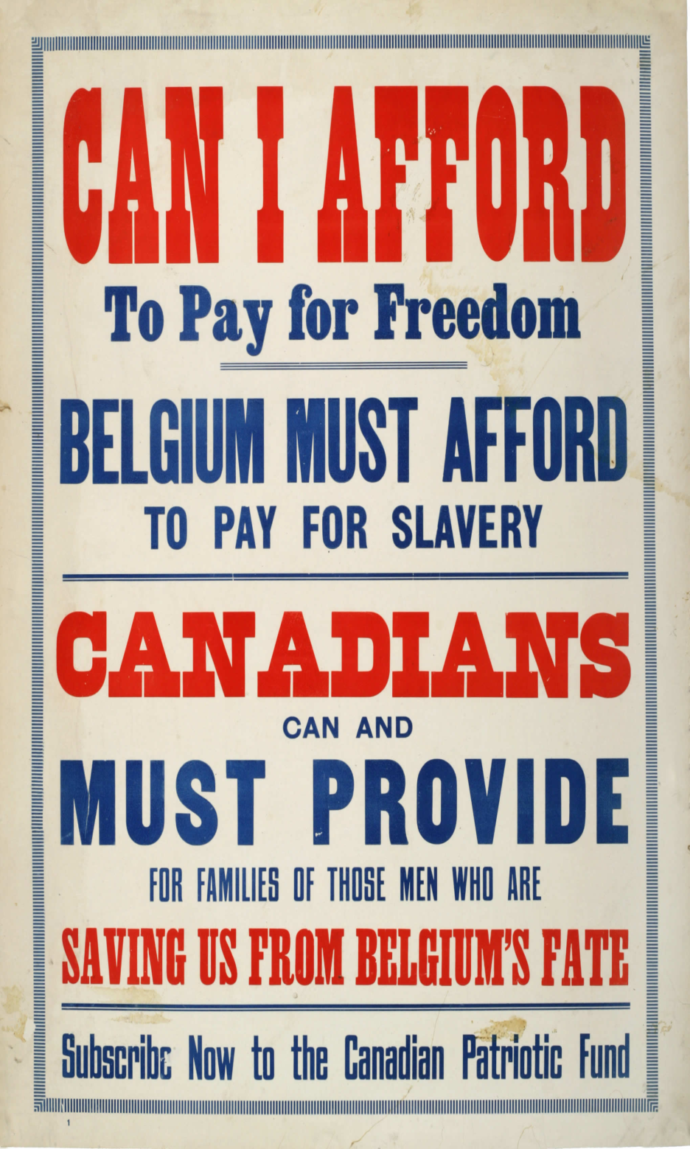
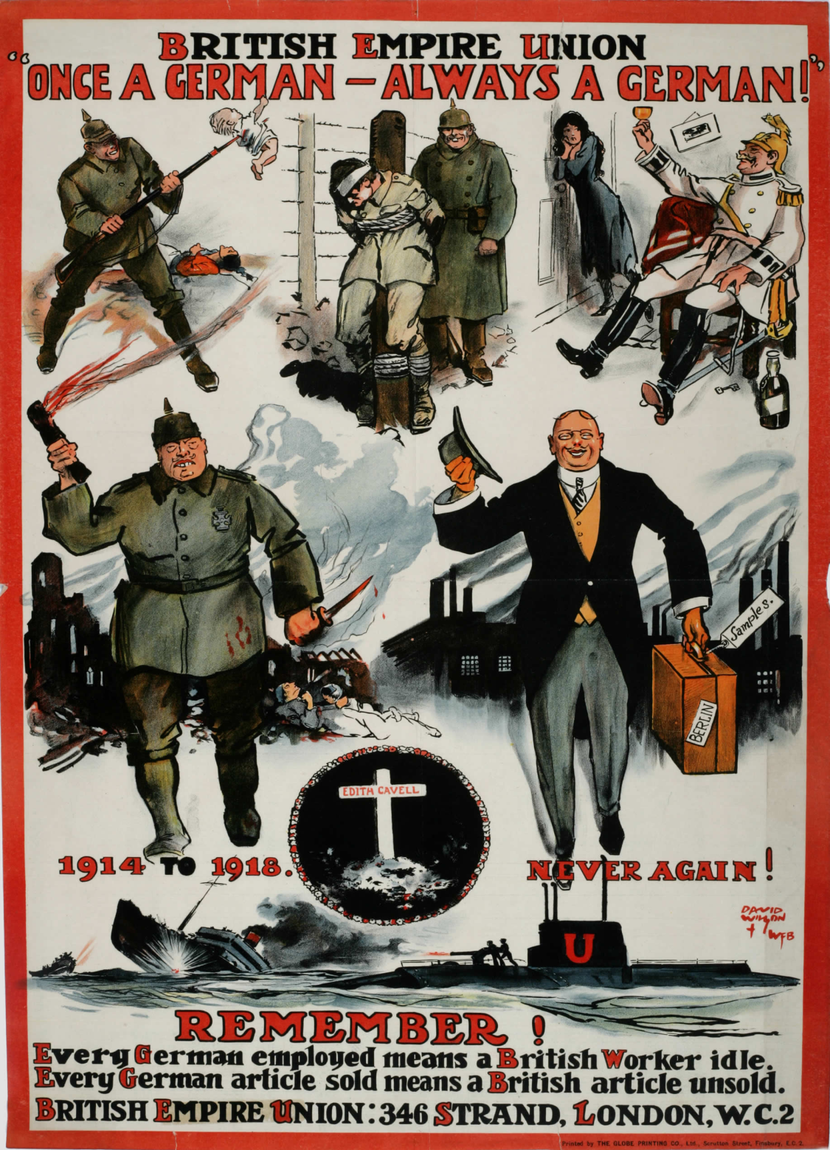

Slide 8
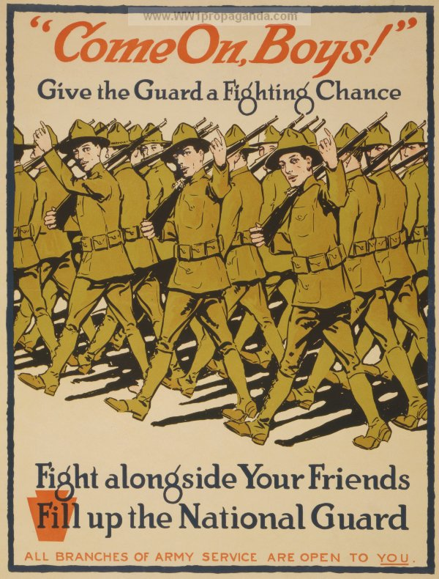
Your Country Needs You!
Notes:
Famous Lord Kitchener recruitment poster (September 1914)

Slide 9
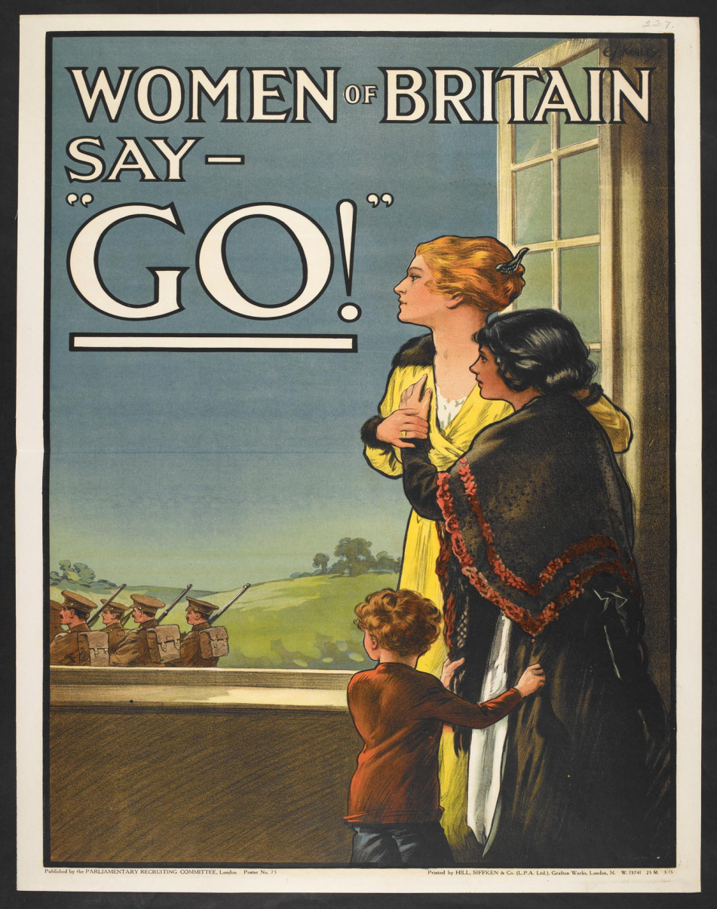
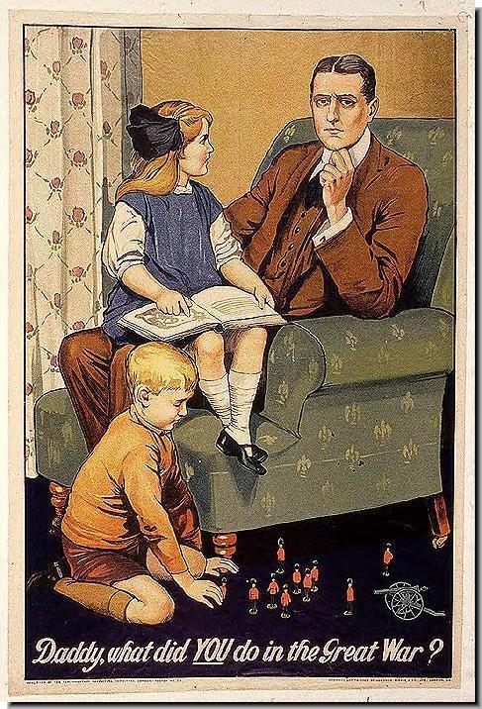
Your Country Needs You!
Notes:
Poster commissioned by the British Parliamentary Recruiting Committee, published in 1915. By this time the war was already being referred to as “The Great War”
Women of Britain Say GO!- a propaganda poster appealing to Britain’s women to ensure their men to enlist.

Slide 10
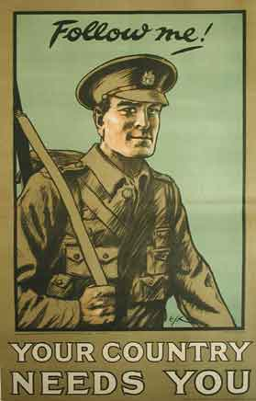
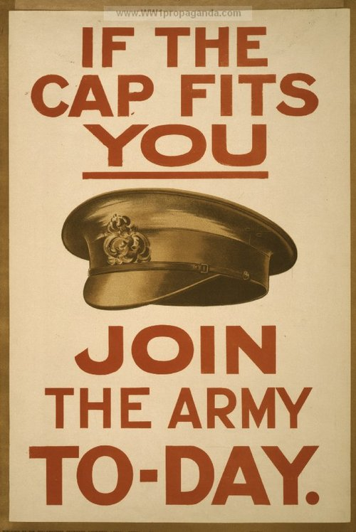
Your Country Needs You!

Slide 11
Patriotism and Nationalism

Slide 12
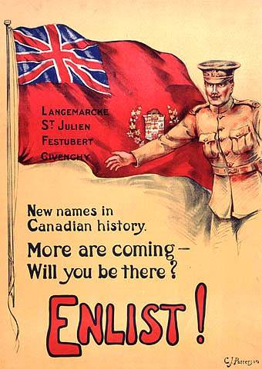
Patriotism and Nationalism

Slide 13
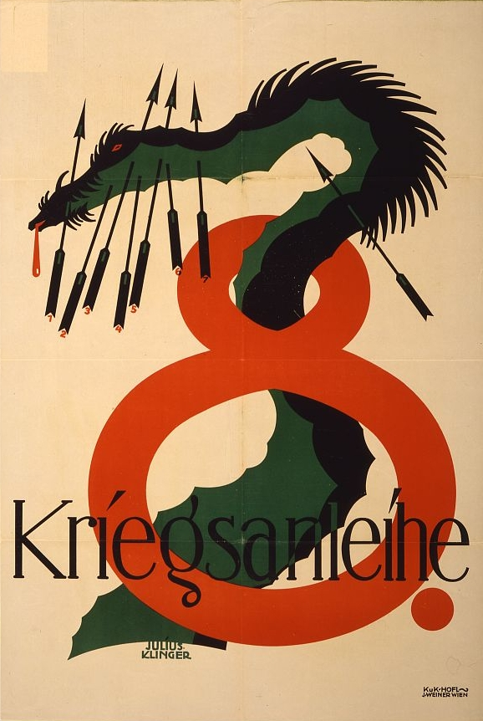
Depicting the Enemy

Slide 14
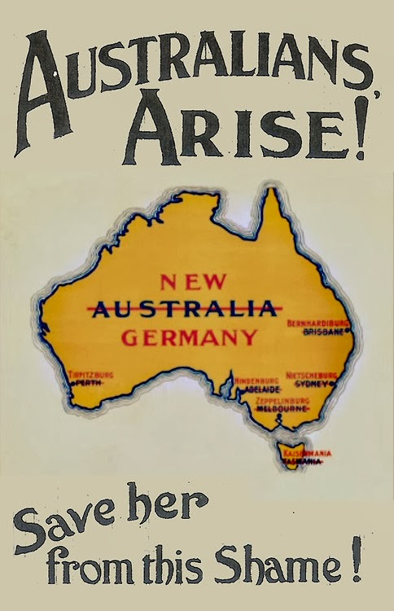
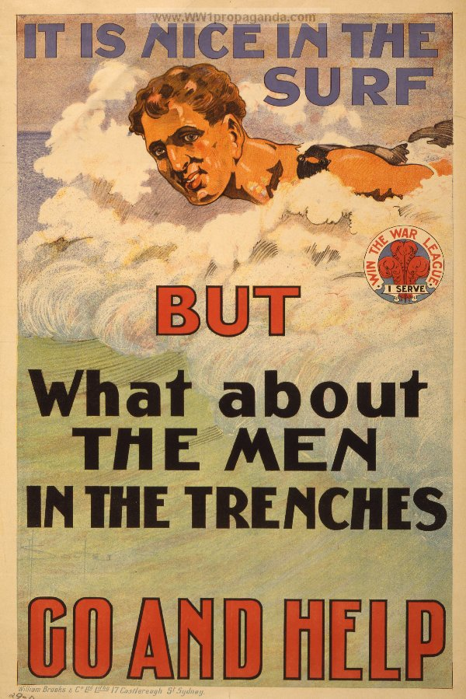
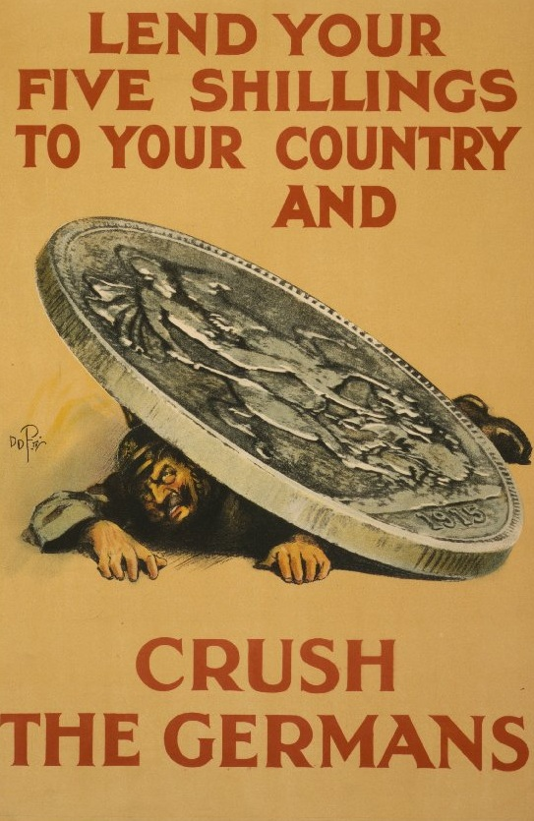
Australia & Great Britain

Slide 15
Women and Propaganda
Women were used as:
symbols
victims
homemakers

Slide 16
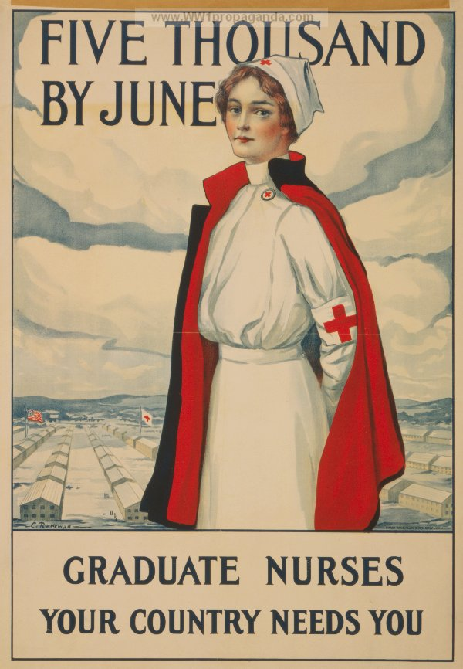
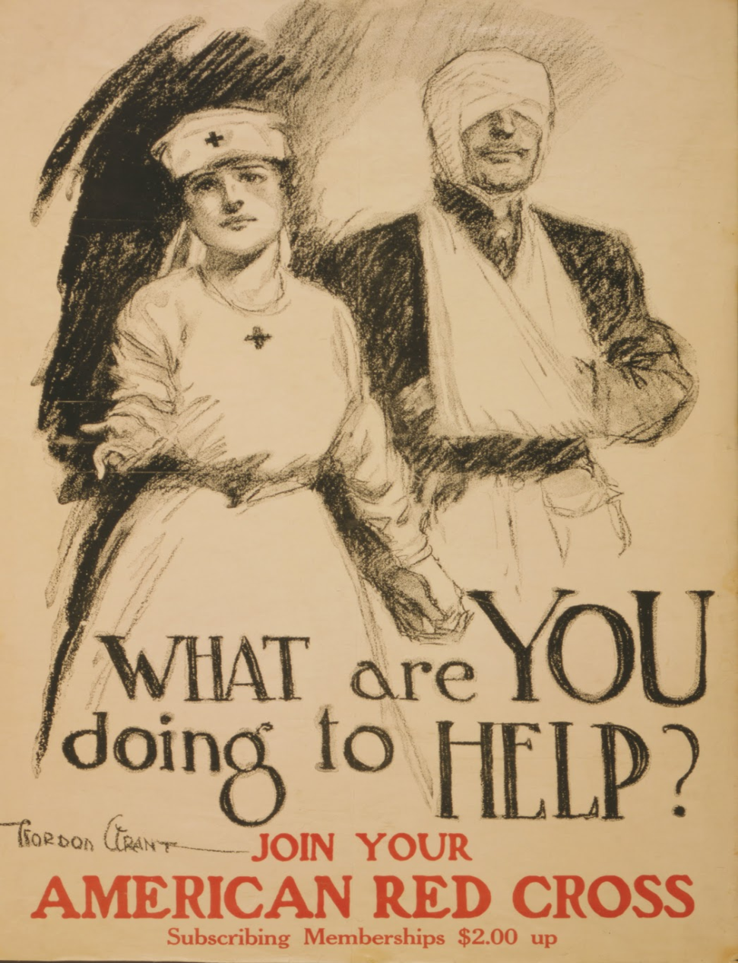
Women and Propaganda

Slide 17
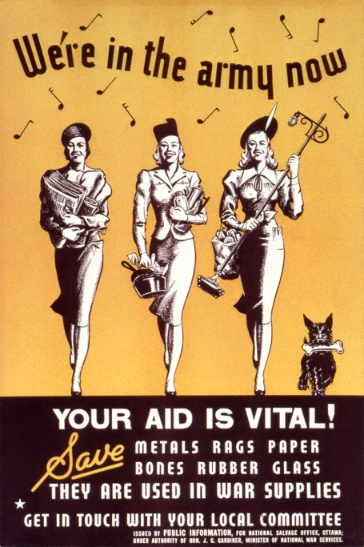

Slide 18
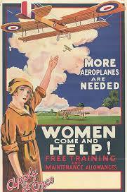
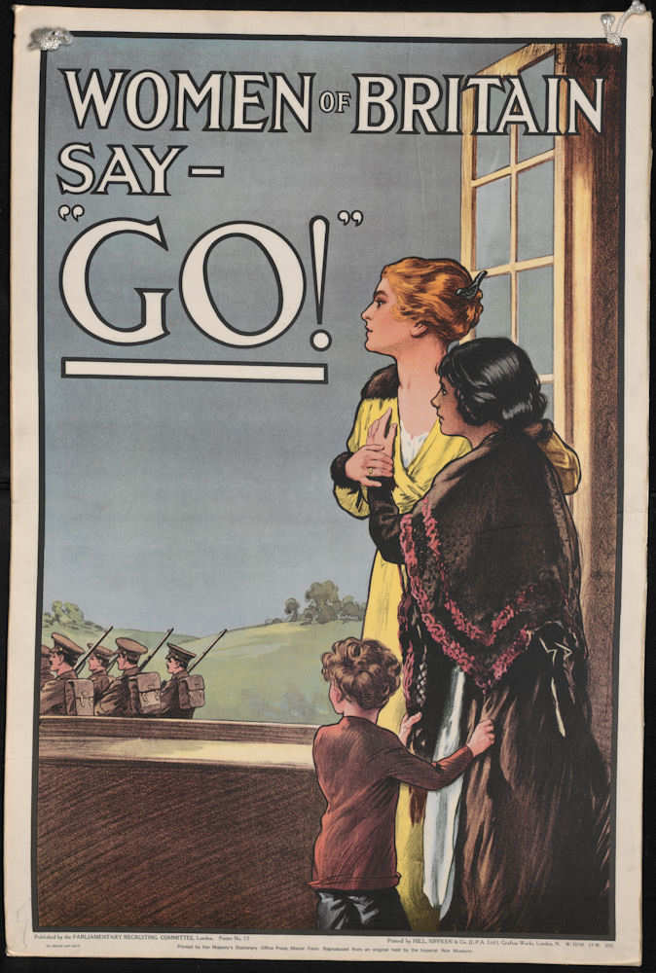

Slide 19
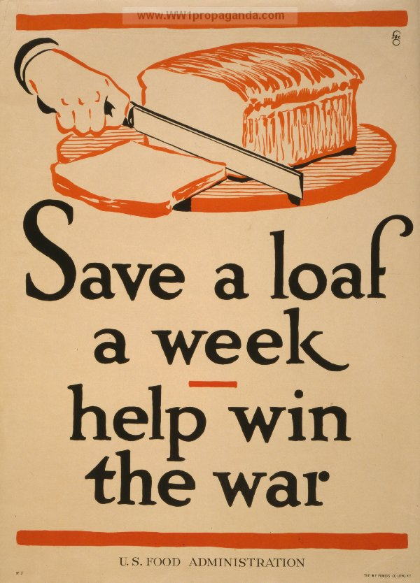

Slide 20
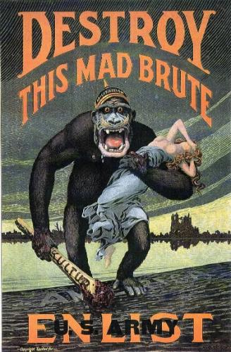
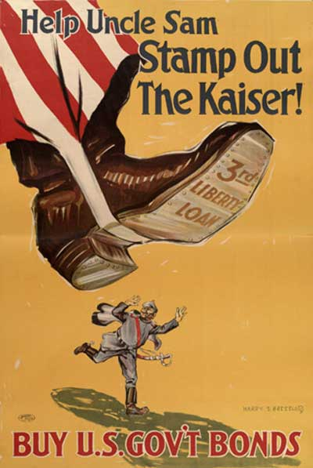
US Propaganda

Slide 21
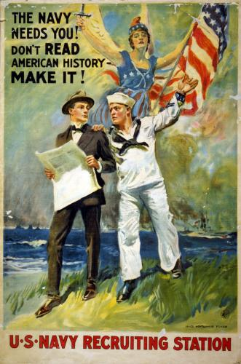
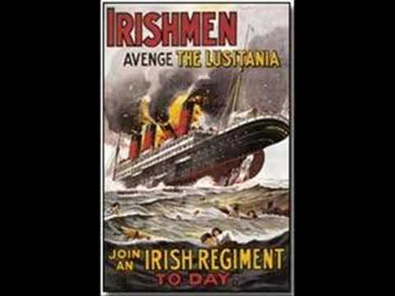
American & Irish Propaganda

Slide 22
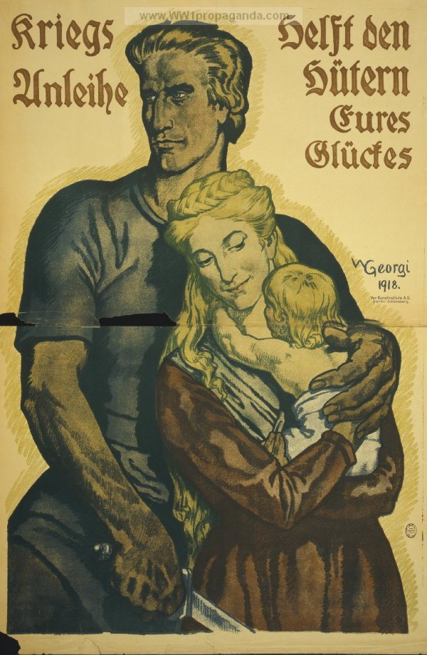
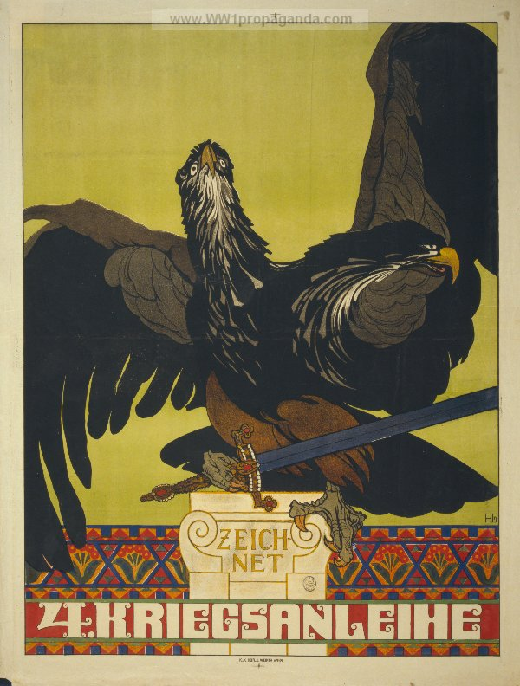
German Propaganda
Notes:
Kriegs Anleihe- War Bonds (Bond Drives)
Unlike France and Britain, at the outbreak of the First World War Germany found itself largely excluded from international financial markets. This became most apparent after an attempt to float a major loan on Wall Street failed in 1914.As such, Germany was largely limited to domestic borrowing, which was induced by a series of war credit bills passing the Reichstag. This took place in many forms; however, the most publicised were the public war bond (Kriegsanleihe) drives.
Nine bond drives were conducted over the length of the war and, as in Austria-Hungary, the loans were issued at six-month intervals. The drives themselves would often last several weeks, during which there was extensive use of propaganda via all possible media. Most bonds had a rate of return of 5% and were redeemable over a ten-year period, in semi-annual payments. Like war bonds in other countries, the German war bonds drives were designed to be extravagant displays of patriotism and the bonds were sold through banks, post offices and other financial institutions.

Slide 23
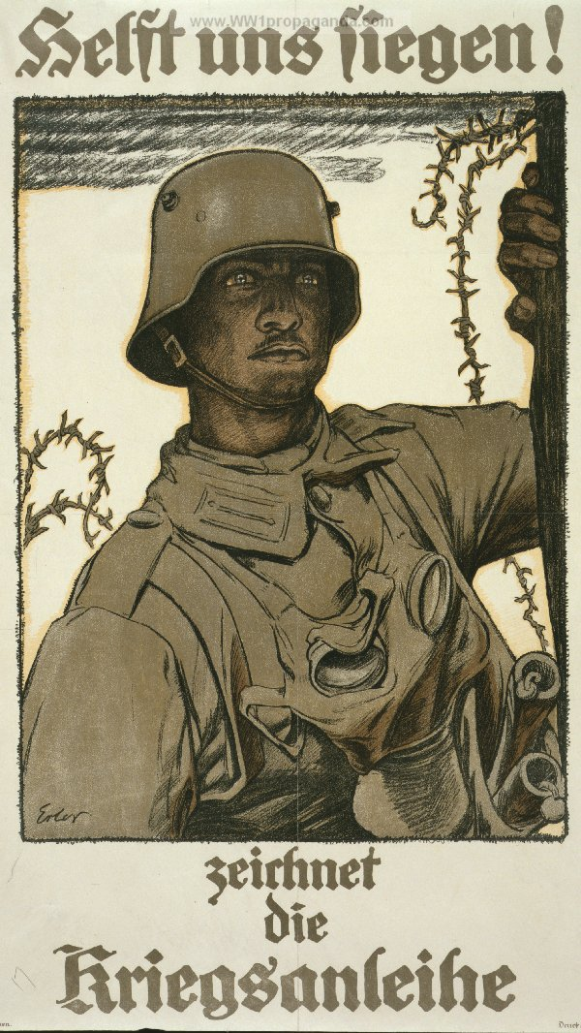
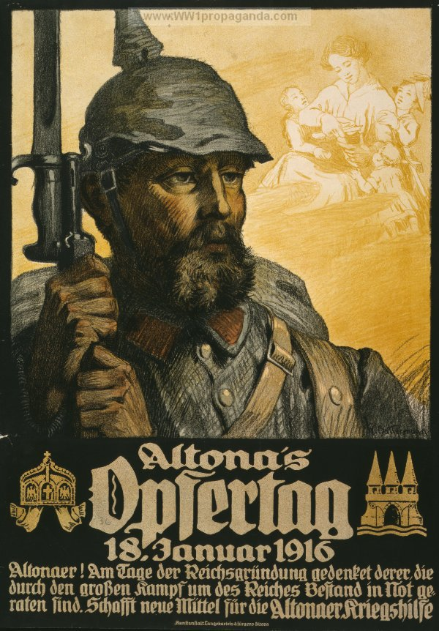
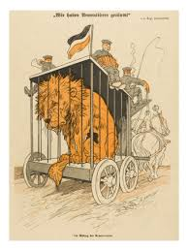
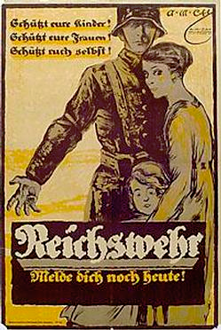

Slide 24
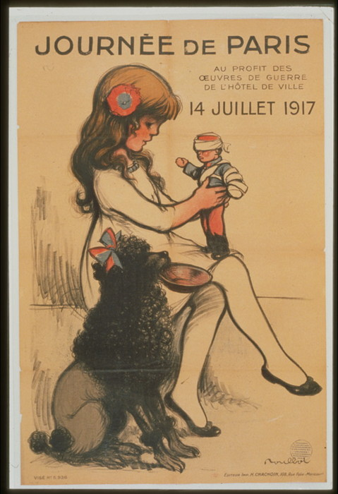
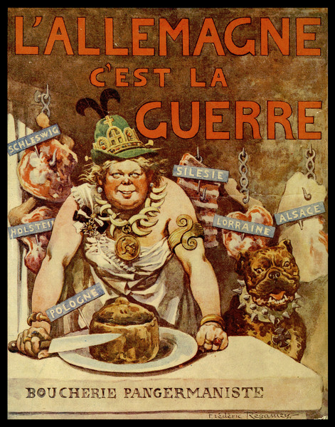
French Propaganda
Notes:
Germany is the brute

Slide 25
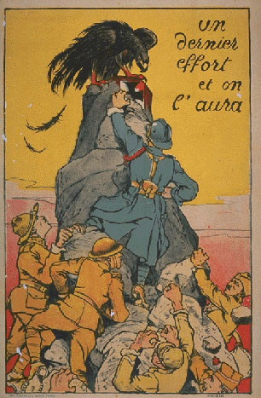
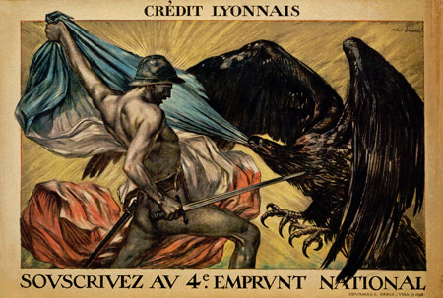

Slide 26
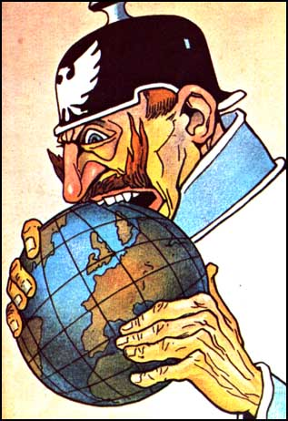
Notes:
A 1915 Italian poster showing Kaiser Wilhelm 2.

Slide 27
Atrocity Propaganda
Atrocity propaganda focused on the most violent acts committed by the German and Austro-Hungarian armies, emphasizing their barbarity and providing justification for the conflict.

Slide 28
Propaganda & Truth
Propaganda was used in World War One as in any war - and the truth suffered.
Propaganda ensured that the people only got to know what their governments wanted them to know.
In World War One, the lengths to which governments would go to in an effort to blacken the enemy’s name reached a new level.

Slide 29
Propaganda was controlling
To ensure that everybody thought in the way the government wanted, all forms of information were controlled.
Newspapers were expected to print what the government wanted the reader to read.
The newspapers of Britain, printed headlines that were designed to stir up emotions regardless of whether they were accurate or not.

