Slide 1
Making PowerPoint Slides
Avoiding the Pitfalls of Bad Slides or How to Make a Better Slide Presentation
By Mr. C. Janzen

Slide 2
Tips to be Covered
Outlines
Slide Structure
Fonts
Colour
Background
Pictures
Graphs
Spelling and Grammar
Conclusions
Questions

Slide 3
Outline
Make your 1st or 2nd slide an outline of your presentation
  Ex: previous slide
Follow the order of your outline for the rest of the presentation
Only place main points on the outline slide
  Ex: Use the titles of each slide as main points

Slide 4
Slide Structure – Good
Use 1-2 slides per minute of your presentation
Write in point form, not complete sentences
Include 4-5 points per slide
Avoid wordiness: use key words and phrases only

Slide 5
Slide Structure - Bad
This page contains too many words for a presentation slide. It is not written in point form, making it difficult both for your audience to read and for you to present each point. Although there are exactly the same number of points on this slide as the previous slide, it looks much more complicated. In short, your audience will spend too much time trying to read this paragraph instead of listening to you.

Slide 6
Slide Structure – Good
Show one point at a time:
  Will help audience concentrate on what you are saying
  Will prevent audience from reading ahead
  Will help you keep your presentation focused

Slide 7
Slide Structure - Bad
Do not use distracting animation
Do not go overboard with the animation
Be consistent with the animation that you use

Slide 8
Fonts - Good
Use at least an 18-point font
Use different size fonts for main points and secondary points
  this font is 24-point, the main point font is 28-point, and the title font is 36-point
Use a standard font like Times New Roman or Arial

Slide 9
Fonts - Bad
If you use a small font, your audience won’t be able to read what you have written
CAPITALIZE ONLY WHEN NECESSARY. IT IS DIFFICULT TO READ
Don’t use a complicated font

Slide 10
Colour - Good
Use a colour of font that contrasts sharply with the background
  Ex: blue font on white background
Use colour to reinforce the logic of your structure
  Ex: light blue title and dark blue text
Use colour to emphasize a point
  But only use this occasionally

Slide 11
Colour - Bad
Using a font colour that does not contrast with the background colour is hard to read
Using colour for decoration is distracting and annoying.
Using a different colour for each point is unnecessary
  Using a different colour for secondary points is also unnecessary
Trying to be creative can also be bad

Slide 12
Background - Good
Use backgrounds such as this one that are attractive but simple
Use backgrounds which are light
Use the same background consistently throughout your presentation

Slide 13
Background – Bad
Avoid backgrounds that are distracting or difficult to read from
Always be consistent with the background that you use

Slide 14
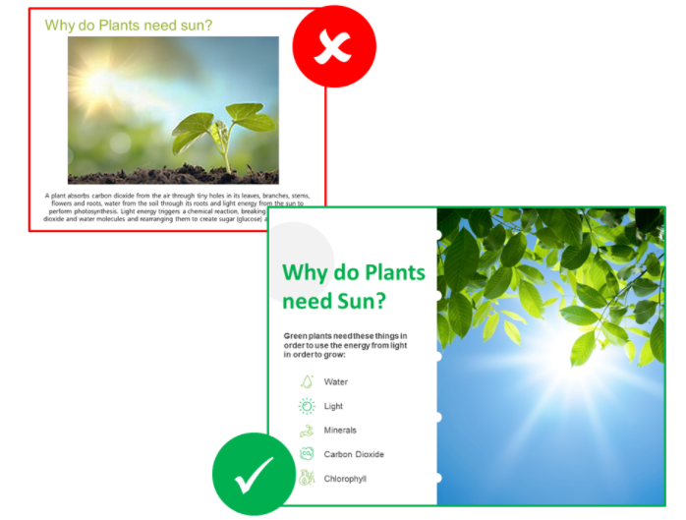
Pictures - Good
No - blurry or unclear images
No - pixilated images
Yes – sharp, relevant images
Yes – large sized images (1080 k)

Slide 15
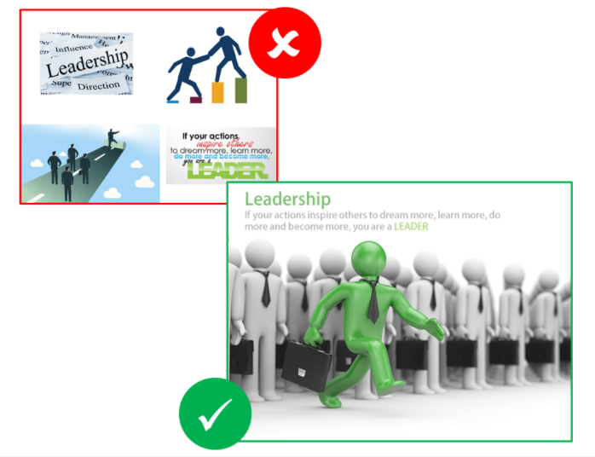
Pictures - Good
Too many pictures per slide is distracting
Create a focal image or uniformity with many

Slide 16
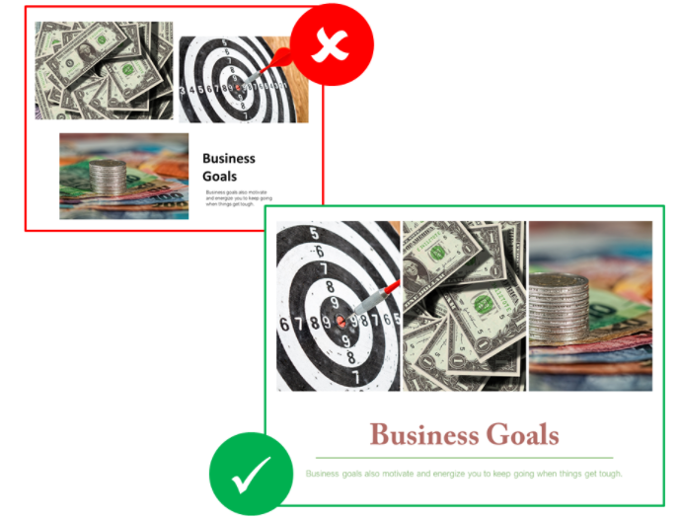
Pictures - Good
Too many pictures per slide is distracting
Create a focal image or uniformity with many

Slide 17
Pictures – Images over Words
Pictures that support the purpose of the slide versus words explaining a concept…
Example – The moon reflect different amount of light as it travels around the sun.
OR

Slide 18

Pictures – Images over Words
Choose your pictures to ILLUSTRATE a talking point
Example – The moon reflect different amount of light as it travels around the sun.
But does this picture ILLUSTRATE the concept or just show a picture?

Slide 19
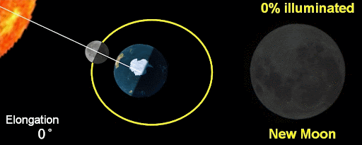
Pictures – Images over Words
Pictures that support the purpose of the slide versus words explaining a concept…
This picture ILLUSTRATES the concept, helping explain your point

Slide 20
Graphs - Good
Use graphs rather than just charts and words
  Data in graphs is easier to comprehend & retain than is raw data
  Trends are easier to visualize in graph form
Always title your graphs

Slide 21
Graphs - Bad

Slide 22
Graphs - Good

Slide 23
Graphs - Bad

Slide 24
Graphs - Bad
Minor gridlines are unnecessary
Font is too small
Colours are illogical
Title is missing
Shading is distracting

Slide 25
Spelling and Grammar
Proof your slides for:
  speling mistakes
  the use of of repeated words
  grammatical errors you might have make

Slide 26
Conclusion
Use an effective and strong closing
  Your audience is likely to remember your last words
Use a conclusion slide to:
  Summarize the main points of your presentation
  Suggest future avenues of research

Slide 27
Questions??
End your presentation with a simple question slide to:
  Invite your audience to ask questions
  Provide a visual aid during question period
  Avoid ending a presentation abruptly

