Slide 1

Thoughtful conversations
How to Engage Your Audience

Slide 2
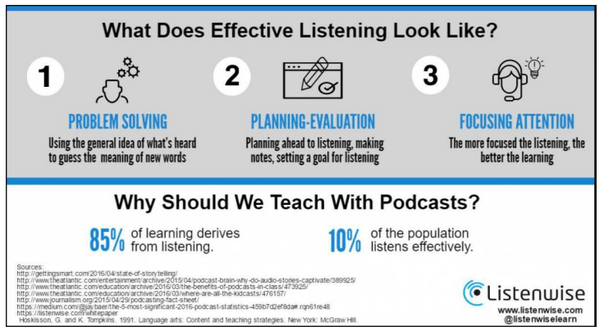
Getting your ideas across
Listening is the most effective method for people to gain information.
Two main methods for information exchange
  Conversations
  Monologue

Slide 3
TED Talks versus Podcasting - Ideas are the currency of the 21st Century
TED Talks
Discuss specific topics – building curiosity in one idea
They are short – no more than 18 minutes "long enough to be serious and sort enough to hold people's attention"
They are focused – one speaker – no other format
Appeal to emotion and rational thought – a balance between the antidotal story and rational data
Podcasting
The positive aspects of podcast listening
You can relate to others – listening to the personal experiences of others
You can learn something – knowledge-based content
You can relax – provides a good laugh, engaging and satisfying episodic form
Source of Inspiration – motivational podcasts, stories of personal journeys are uplifting

Slide 4
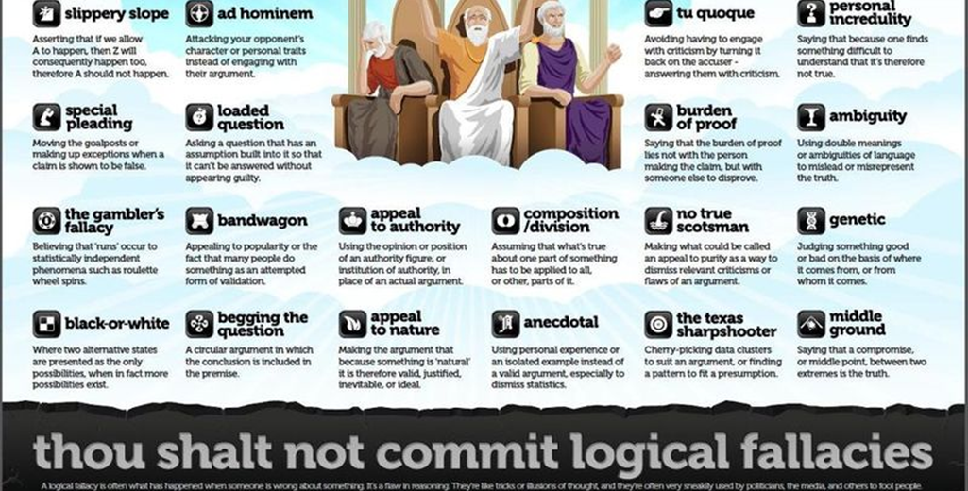

Slide 5

Getting your guest at ease...
Joe asks Elon about X Æ A-12, his child born during COVID-19 outbreak

Slide 6
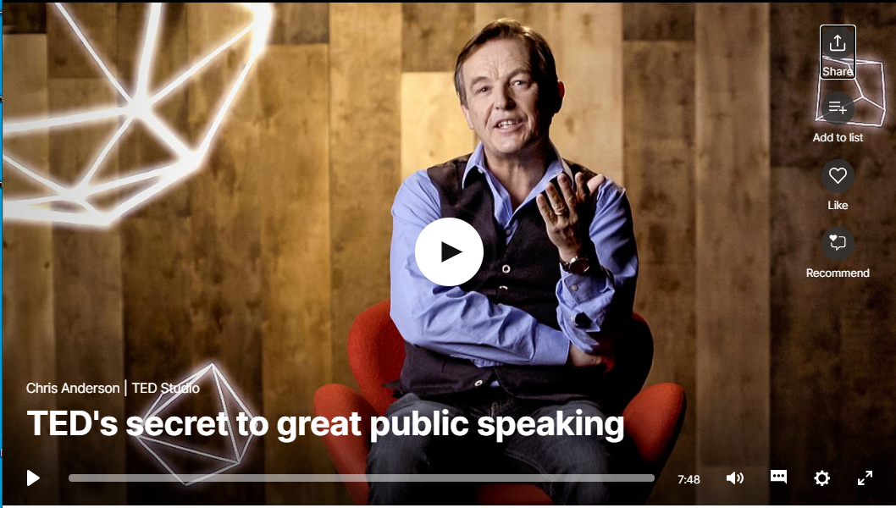
Appeling to curiosity
TED Talks founder gives tips on how to speak...
https://www.ted.com/talks/chris_anderson_ted_s_secret_to_great_public_speaking

Slide 7

Lessons to learn...
Focus on one major idea
Give people a reason to care
Build your ideas with familiar concepts
Make your idea worth sharing

Slide 8
Where do we go from here?
Starting a story
  https://training.npr.org/2016/12/13/beyond-the-5ws-what-should-you-ask-before-starting-a-story/
TED Talks Resources
  Preparing a TED Talk
    https://diyclassroom.weebly.com/activities-for-students/prepare-a-ted-talk
Podcast Resources
How to start an audio story
  https://www.npr.org/2018/10/30/662070097/starting-your-podcast-a-guide-for-students#structure

