Slide 1


How to make a PowerPoint
A Short Guide

Slide 2
Table of Contents
Choosing your design.
Adding media.
Finishing with Animation

Slide 3
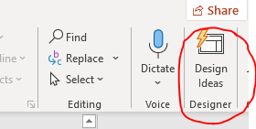
Choosing Your Design
Create a new file and select a design for it.
  Further customize the slides using “Format Background” under the “Design “ Tab
Use the Design Ideas button under the “Home” Tab” to further customize your content.

Slide 4
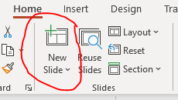
Choosing Your Design - continued
Select slide types that include space for both text and pictures.
  Use the “New Slide” button under the “Home” Tab to choose a preset slide type.
  Customize the text box size, font size, type, and colour

Slide 5
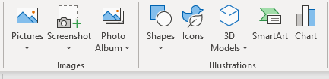
Adding Media
Each Slide should contain an element of graphics (picture, vector, video)
Select “Pictures”, “Video”, “Audio” from the “Insert” Tab
Choices include “Stock”, “Online”, or “Saved” Media sources
Include a screen shot if necessary or a screen recording to enhance the presentation
Add “Shapes”, “Icons”, “Smart Art”, and/or “Word Art” to enhance each slide with meaningful visuals
Media (and text) can be enhanced with the “Link” or “Action” button

Slide 6
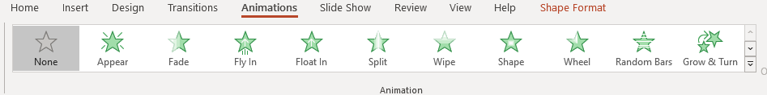
Finishing with Animation
Add “Transitions” to your Show to move between slides.
Choose a Transition Type under the “Transitions” Tab
Decide on the movement from slide-to-slide based on “Mouse Click” or within a selected amount of time
And “Animations” to a limited selections of text or graphics to provide additional interest to your presentation

Slide 7

Conclusion
What we know about PowerPoint now
PowerPoint is a Visual Learning Tool
Presentations include Text and Graphics
PowerPoint software has many elements lurking beneath the surface
What is still left to learn.

