Slide 1
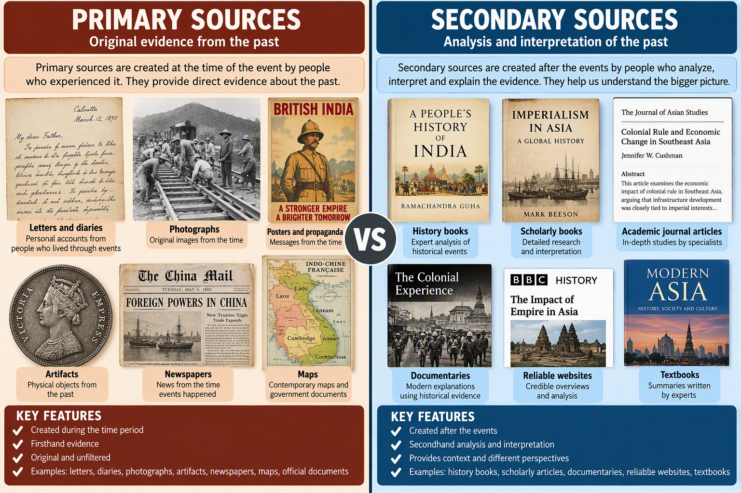

Primary vs. Secondary Sources
Use Sources Like a Historian

Slide 2
Identify primary and secondary sources
Find sources for Imperialism on Trial
Evaluate source quality
Learning Goals

Slide 3
What is a Primary Source?
Original evidence created during the time being studied.

Slide 4
• Treaty of Nanjing (1842)
• Indian nationalist letters
• British East India Company reports
• Photographs from treaty ports
• French Indochina colonial maps
• Emilio Aguinaldo speeches
Primary Sources - Asian Imperialism

Slide 5
What is a Secondary Source?
Analysis or interpretation created later.

Slide 6
• Books on Asian Colonialism
• News Articles
• GALE or EBSCO journal articles
• BBC History Website
• Britannica or Other Encyclopedias
• Academic documentaries or podcasts
Secondary Sources –
Asian Imperialism

Slide 7
How to Find Google and Sweet Search Primary Sources
Define Research Topic
& Keywords
1. Digital Keywords
Add exact phrases like:
• "digital collection"
• "digital archive"
• "oral history"
2. Domain Limits
Filter by trusted site types:
• site:.edu (Universities)
• site:.gov (Government)
• site:.org (Museums)
3. Boolean Logic
Refine search operators:
• Use Quotes "" for phrases
• Capital OR for synonyms
• Parentheses ( ) to group
4. Google Scholar
Leverage advanced filters:
• Select "Content I can access"
• Set custom historical date ranges
Execute Search &
Evaluate Sources

Slide 8
How to Find Good History Sources on Google or Sweet Search (Secondary Sources)
Follow this simple workflow to skip random blogs and find expert research for Grade 10 projects.
STEP 1
Add Expert Keywords
What to do:
Add terms like "summary", "analysis", or "history of".
Why it helps: This skips opinion posts or generic encyclopedias and pulls up overview articles written by real historians.
STEP 2
Lock onto PDFs
What to do:
Type filetype:pdf right after your search terms.
Why it helps: School textbooks, research papers, and deep historical essays are saved as PDF documents, not regular web pages.
STEP 3
Hide Primary Sources
What to do:
Use a minus sign before raw files (e.g., -diary -letters).
Why it helps: When you need an expert explaining what happened later (instead of a raw old diary entry), this cleans up your results.
STEP 4
Try Google Scholar or Sweet Search - History
What to do:
Go search on scholar.google.com or Sweet Search – History instead
Why it helps: blocks all normal websites, shopping links, and blogs, showing you only books and academic papers.

Slide 9
Google and Sweet Search Search Tips – New and Old Methods
Finding Primary Sources (Raw Evidence)
The Traditional Way (Exact Formula Search): You type an exact string into Google to find old letters, photos, or official government logs.
  Example: "oral history" AND "World War II" site:.gov
The AI Way (The Map Finder):
You ask an AI tool to give you a roadmap of where those old documents are hidden online.
  Prompt: "I am writing a history project on female codebreakers in WWII. What specific university libraries or museum archives have digital collections of their diaries?"

Slide 10
Google and Sweet Search Search Tips – New and Old Methods
Finding Secondary Sources (Expert Analysis)
The Traditional Way (PDF Tracking): You force Google to only show you real history essays and textbook chapters, completely skipping random opinion blogs.
  Example: "League of Nations" "failure" filetype:pdf
The AI Way (The Argument Summarizer): You ask an AI tool to break down a complex historical argument into easy bullet points so you can understand it before writing.
  Prompt:
  "Act as a history teacher. Explain the main reasons why historians argue over whether the League of Nations failed. Who are the famous authors on both sides?"

Slide 11
Example 1 - Treaty of Nanjing =
Primary
1890s Hong Kong photograph =
Primary
Academic Journal Article =
Secondary
BBC History article =
Secondary
YouTube Video =
Secondary
Primary or Secondary?

Slide 12
✓ 2 Primary Sources
✓ 3 Secondary Sources
✓ Notes from each source
✓ MLA/APA citations
✓ Historical evidence
Research Checklist

