Slide 1
Mastering the Rule of Thirds
Create PowerPoint Presentations That Capture the Eye
Design Guide

Slide 2
What is the Rule of Thirds?
[ Visual Focal Point ]
Placed right along the right-hand Power Points.
The 3x3 Grid: Imagine splitting your slide into 3 equal columns and rows. This creates 9 equal blocks.
Power Points: The 4 magic intersections where lines cross are called 'Power Points'.
The Golden Rule: Human eyes naturally look at these intersections first—not the dead centre!

Slide 3

What is the Rule of Thirds?
The 3x3 Grid: Imagine splitting your slide into 3 equal columns and rows. This creates 9 equal blocks.
Power Points: The 4 magic intersections where lines cross are called 'Power Points'.
The Golden Rule: Human eyes naturally look at these intersections first—not the dead centre!

Slide 4
Center-Heavy vs. Thirds Layout
THE MISTAKE: Centered Clutter
Everything is dumped right in the middle.
It looks stiff, boring, and feels like an default auto-generated template.
The eye gets lazy.

Slide 5

Center-Heavy vs. Thirds Layout

Slide 6
Center-Heavy vs. Thirds Layout
THE FIX: Rule of Thirds
Title shifted to the left 1/3 line.
Main graphic or photo anchors the opposite 2/3 space.
Negative space makes it feel high-end and intentional.

Slide 7

Center-Heavy vs. Thirds Layout

Slide 8
Stop Guessing: Turn On Gridlines
Step 1: Locate View Tab
Go up to the top navigation ribbon and click on 'View'.
Step 2: Check 'Gridlines' & 'Guides'
Turn these boxes on. PowerPoint will automatically show layout overlays.
Step 3: Snap Content to Grid
Drag your text boxes, charts, and image borders until they 'snap' cleanly onto the lines.

Slide 9
Left 1/3 for Text
• Keep points ultra-short.
• Use bold keywords.
• Let the empty space breathe.
Right 2/3 Saved For Large Visual Context
(Hero Image, Diagram, or Big Metric Chart)

Slide 10
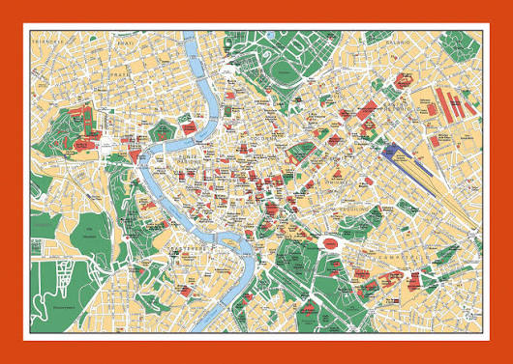
A Map of Rome
• Many great places to see.
• Visit the Vatican.
• Start planning your visit.

Slide 11
Your Quick Slide Checklist
✔ Off-Center Elements — Are main titles/images aligned to a power point or third line?
✔ Negative Space — Is at least 30-40% of your slide completely clear of clutter?
✔ Rule of 3 Content — Are you sticking to roughly 3 main concepts per slide?
✔ Grid Checked — Did you turn on PowerPoint gridlines to verify alignments?

